Slide 1
A Quantitative Assessment of Emerging Trends in IoT Botnet Attacks
M. Hassan Nasir,
Muhammad Mubashir Khan &
Junaid Arshad

Slide 2
OUTLINE
Introduction
Methodology
Results
Conclusions & Future Work

Slide 3
Introduction
IoT Botnet
Network of Compromised Devices (Zombies)
Controlled by Bot Master/Herder
Bibliometric Assessment
Quantitative Analysis by applying Statistical Methods for Evaluating the Literature

Slide 4
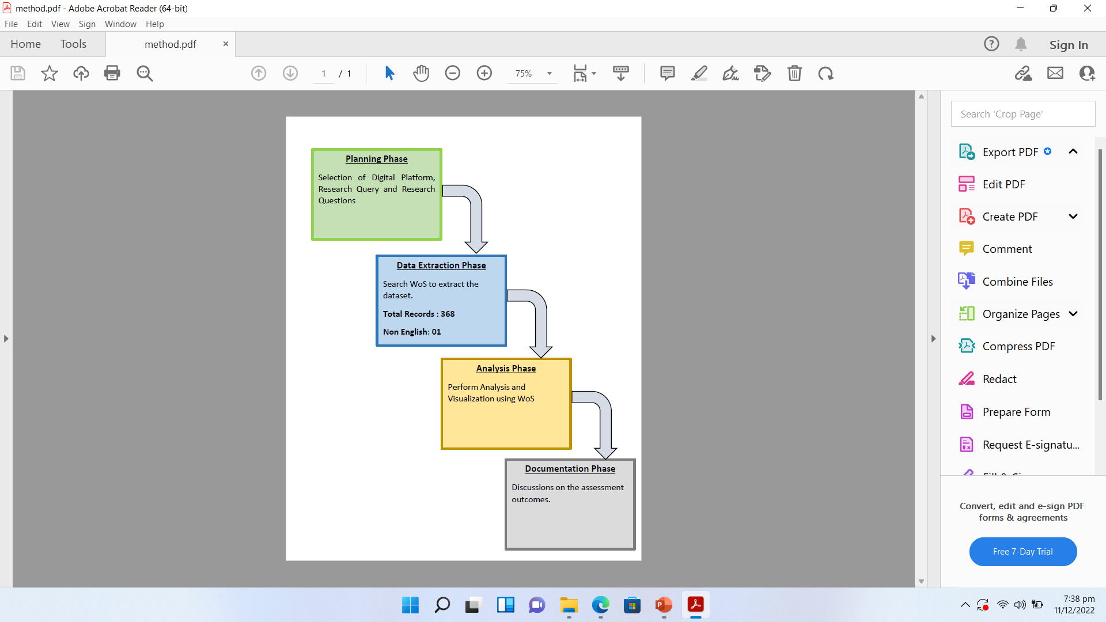
Methodology

Slide 5
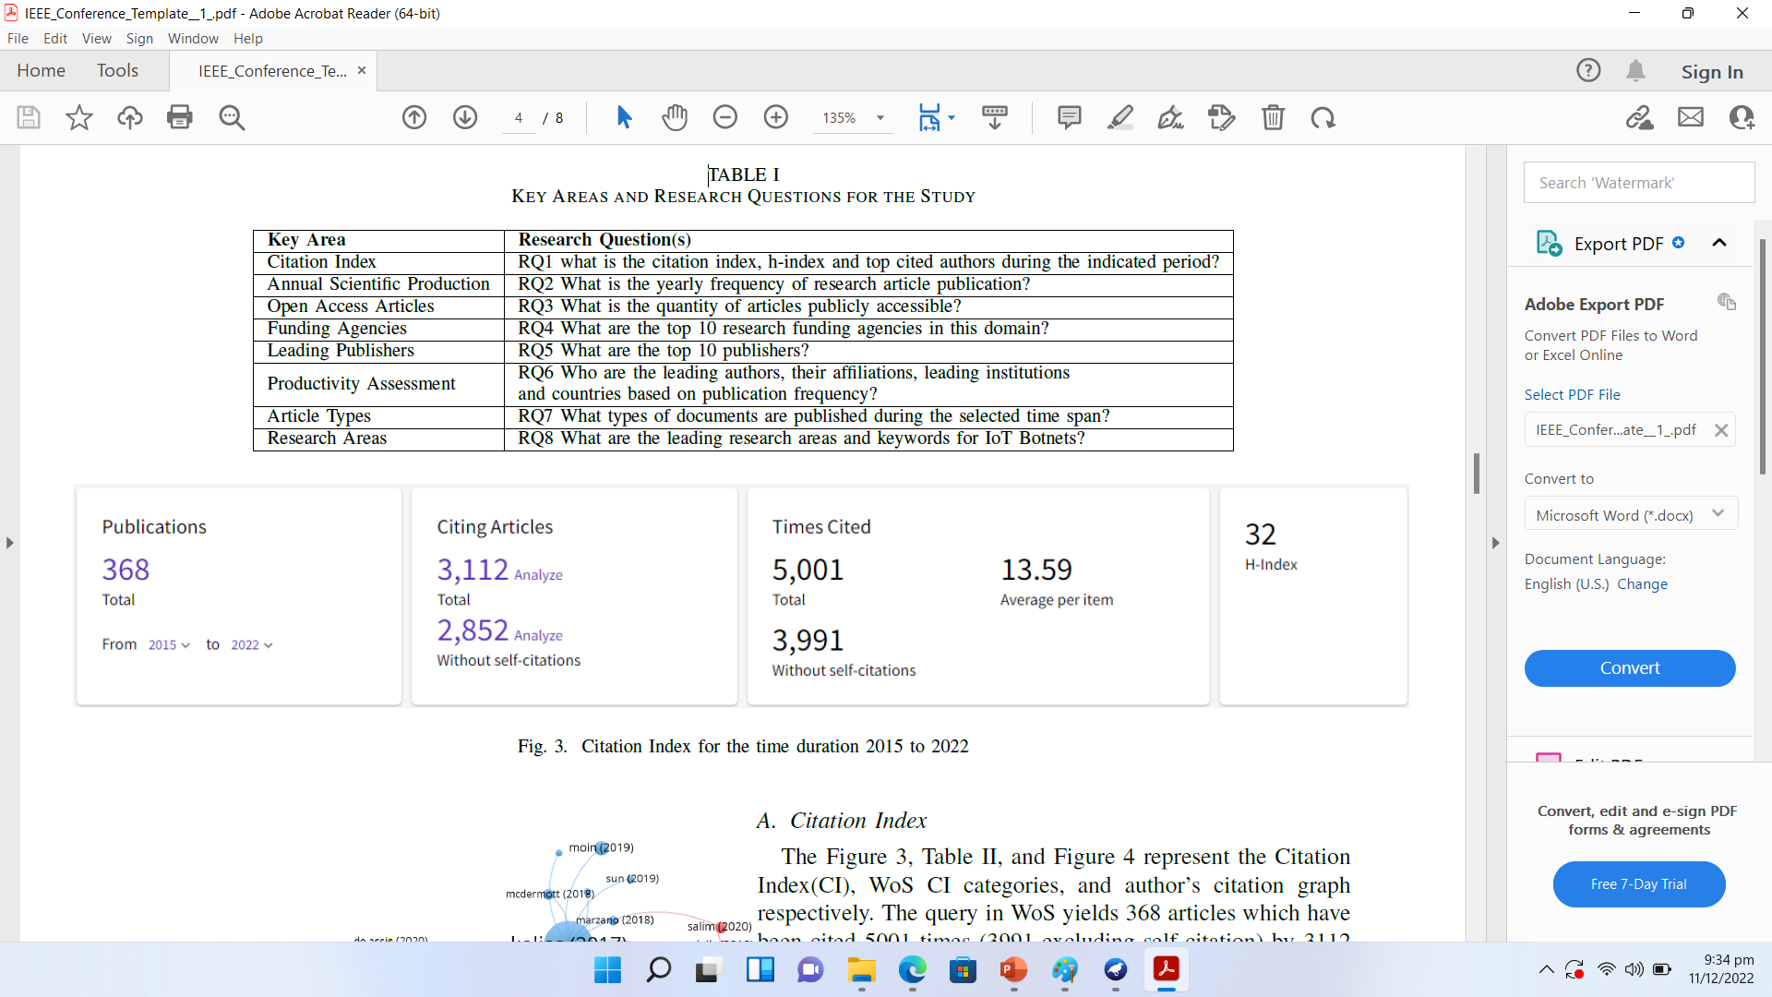
Assessment Questions

Slide 6
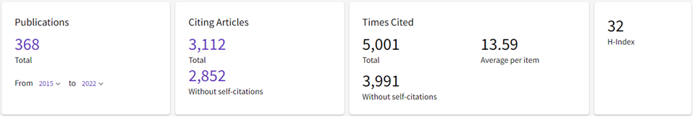
Citation Index

Slide 7
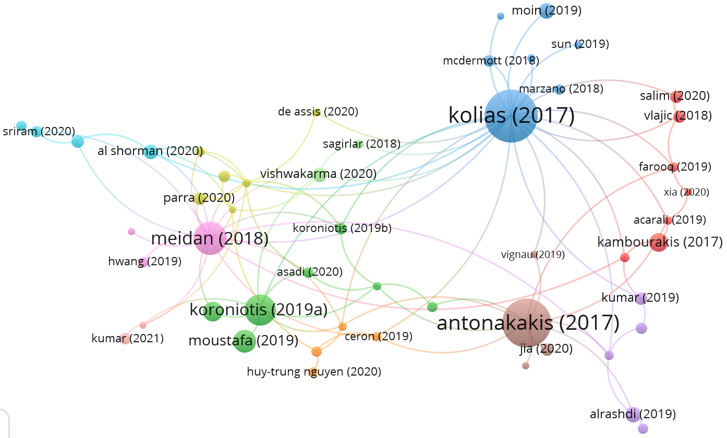
Citation Index

Slide 8
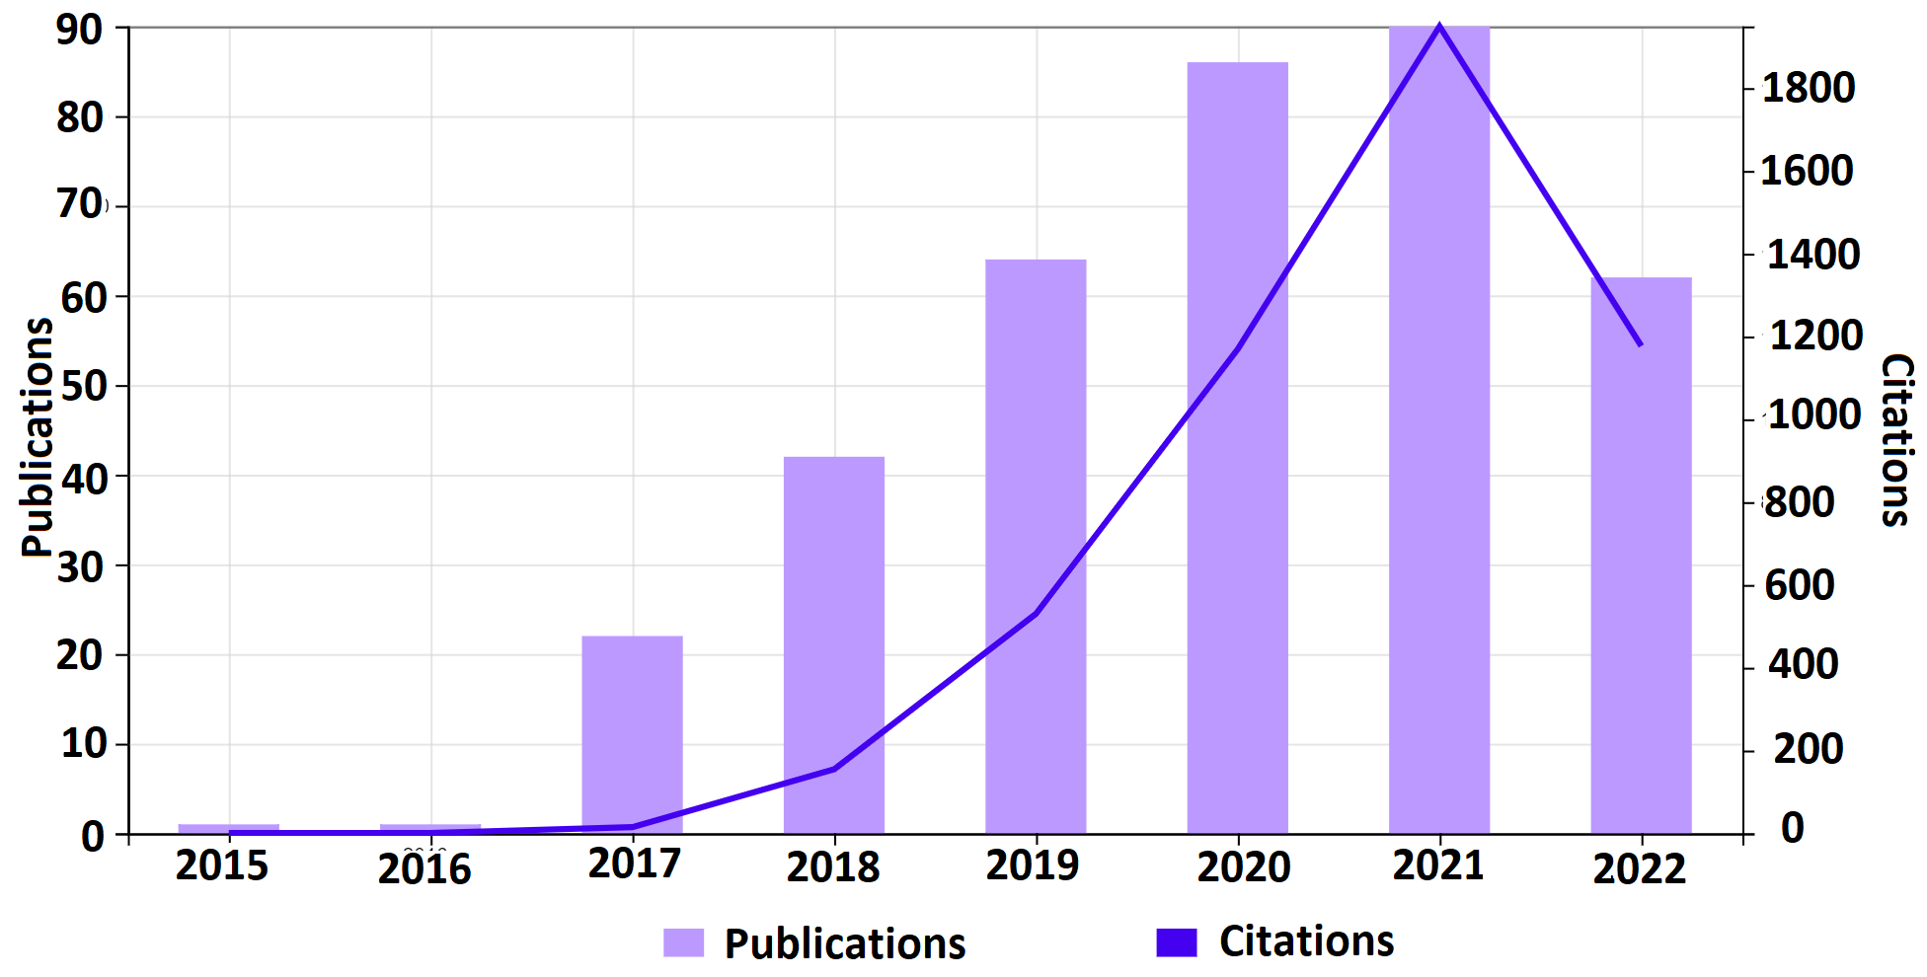
Publications Vs Citations

Slide 9
Open Access Articles
Open Access Articles
134 Open Access Articles (36.4%)
Funding Agencies
53.213 % Research is Funded
National Natural Science Foundation Of China Nsfc funded 27 (7.34%) researches
National Science Foundation Nsf funded 22 (5.9%) researches
Top Publisher
IEEE (167 , 45.38%)
MDPI & Springer Nature (45, 12.23%)
Elsevier (37, 10.05%)

Slide 10
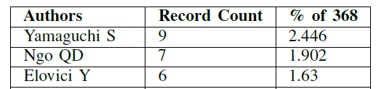
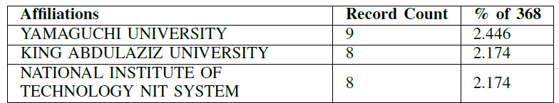
Productivity Assessment
Leading Authors
Top Publishing Institutions

Slide 11
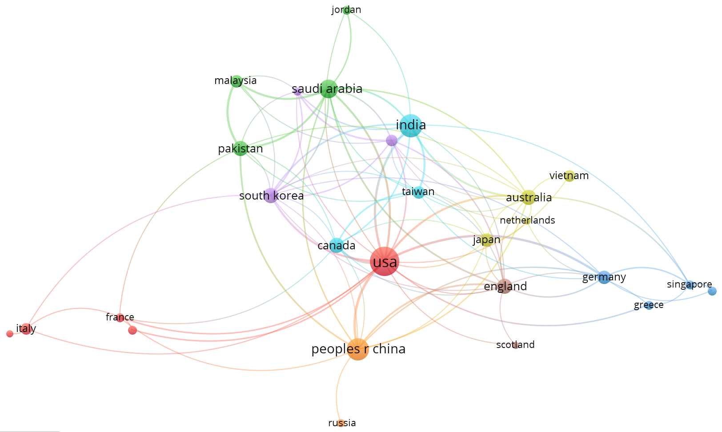
Research Collaboration Network

Slide 12
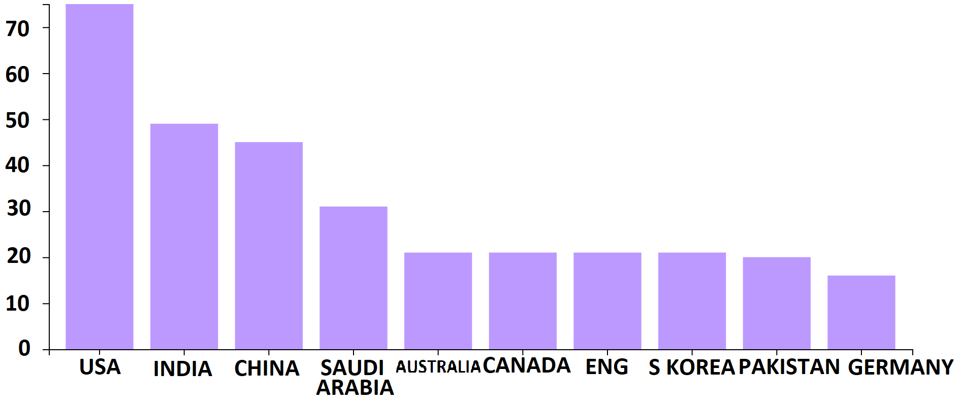
Countries with Most Publications

Slide 13
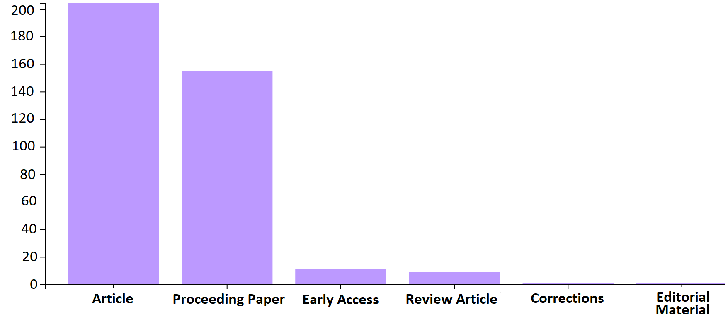
Types of Published Documents

Slide 14
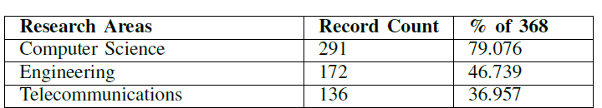
Types of Published Documents

Slide 15
Conclusions & Future Work
This Research Presents:
Basics of Botnet, its Types and operations.
We have also analyzed 368 research Publications in WoS based on 8 research Questions.
Increasing research Trend
Multi-disciplinary Domain
The Increasing IoT-Botnet attacks shows the potential of research in this domain.

Slide 16
Conclusions & Future Work (Cont’d)
This study will consequently help the research community to collaborate with other research scholars, institutions and funding agencies to carry out further research in this area.
Future Work: Systematic Literature Review to find out the Research Gaps in this domain.

Slide 17
Thank You

